Slide 1

Maths at Heathwood Lower School
November 2018

Slide 2
Aims
To gain an understanding of the maths curriculum
To develop knowledge of how maths is taught in your child’s school
To know the fundamental skills of maths
To have a bank of ideas for supporting your child at home

Slide 3
How Maths teaching has changed
To give children the chance to explore ways of finding an answer, and being able to explain why it works
To give them the key skills needed to solve real world problems and examples
To provide opportunities to apply these skills in practical situations

Slide 4
Our Curriculum
Mastery Curriculum
Key Stage areas – Foundation Stage, Keys Stage 1 and Keys Stage 2
Year group – progression
Conceptual areas
Mixed Ability Approach
Notes:
Maths can be applied to various contexts and transferred across the conceptual areas e.g. four rules of number can be developed through measure.

Slide 5
What is Maths Mastery
Achievable for all
All the class working together
Deep and sustainable learning
The ability to reason about a concept
Development of fluency
Consolidation of learning before moving on
Notes:
Mastery – focus on fundamental skills and knowledge before moving on. Children have greater confidence and ability to transfer learning and recall; which can then be applied to increasingly complex problem solving.
Maths can be applied to various contexts and transferred across the conceptual areas e.g. four rules of number can be developed through measure.

Slide 6
Fluency
Efficiency – Can carry out steps easily without losing track of the problem.
Accuracy – Careful recording and knowledge of number facts.
Flexibility – Using more than one approach to solving a problem and using an appropriate method.
Quick recall of facts and procedures.
Ability to recognise relationships.
Notes:
Use of Flurrish daily to practice multiplication facts and number bonds – this allows children to spend more time problem solving

Slide 7
What does fluency look like?

Slide 8
Developing understanding
Prompting thinking & questioning
Providing opportunities to manipulate, experience and see (use of resources)
Develop thinking through investigation
Reasoning and making connections – What’s the same? What’s different?
Engaging in talk
Enabling learning through drawing attention to – tell me what you notice.
Encouraging children to make links and generalise
Notes:
Maths is about spotting patterns, making links and understanding how pieces of knowledge fit together. NOT purely memorising facts and procedures by rote.

Slide 9
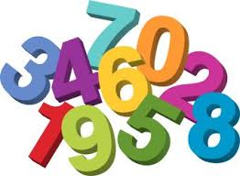
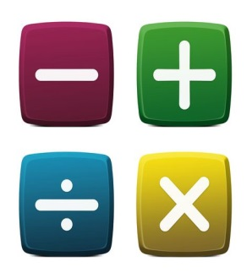
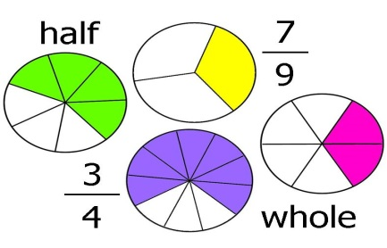


Key Concepts
Number and Place Value
Addition and Subtraction
Multiplication and Division
Fractions
Measure
Geometry
Statistics
Notes:
Maths is learnt through all of these concepts and skills can be transferred across the many different areas of maths. Multiplication and division can support children with exploring and understanding fractions.

Slide 10
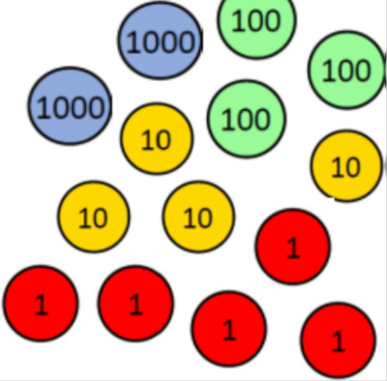
Number, Place Value & Calculating
Thousands, hundreds, tens, ones, tenths & hundredths
Representation
Practical Resources to written methods
Concrete – Pictorial – Abstract
2345+1453=
Notes:
Heavy weight of the curriculum and what we need in maths relies heavily on their understanding of number and place value and in order to move forward with their learning is essential for children to have grasped an understanding of place value and the number system. We place a strong emphasis on the use of practical manipulatives to develop children’s understanding of place value, which they can then apply to more complex problem solving. Representation is the key to showing understanding.

Slide 11
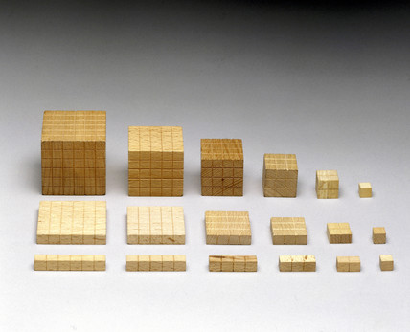
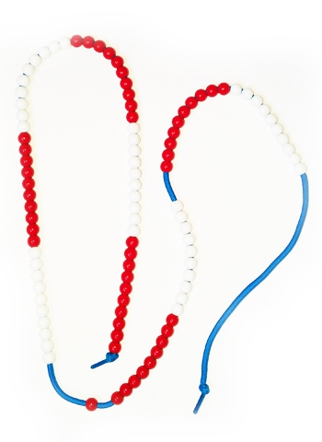
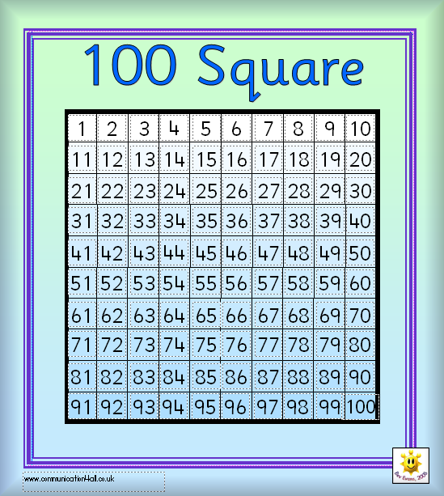
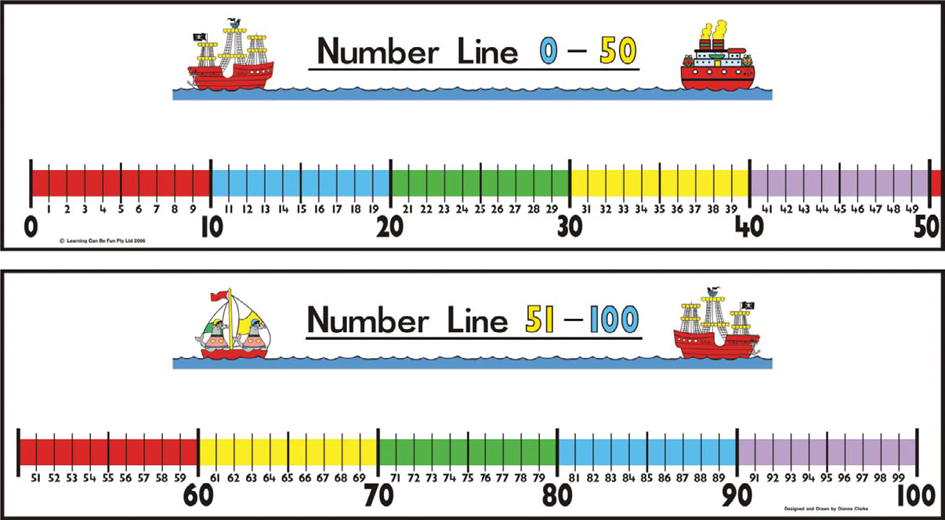
Resources to support understanding
Notes:
Around the room are some activities to try – try using the resources to show understanding rather than just solving it because you can.
We teach children methods, but support with multiple images and resources so children can see how maths works. Some resources work better for different calculations and its important that the children realise this.

Slide 12
Images and models

Slide 13
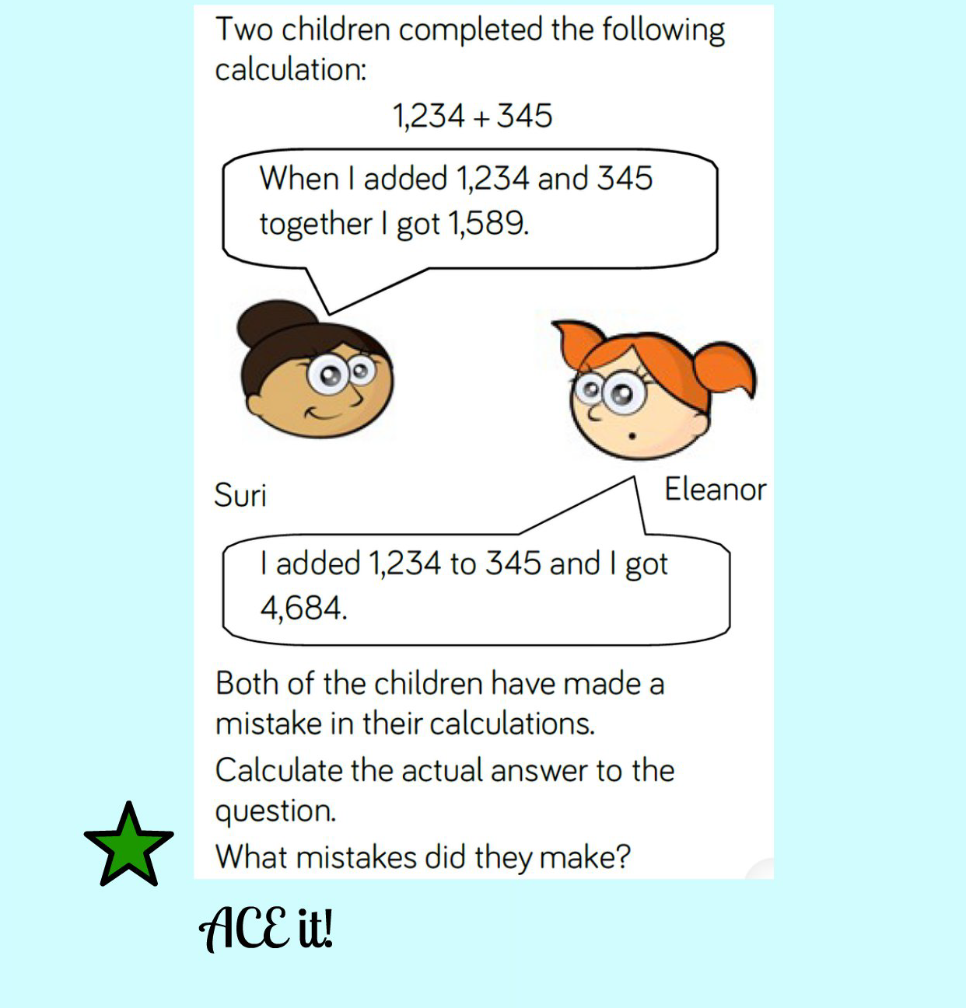
Reasoning
Answer
Convince
Explain

Slide 14

Helping at home KS1/ FS
Play board games
Cook – measuring and weighing
Look at numbers in the environment e.g. telephone keys, number plates, door numbers, book pages, sleeps until Christmas!
Money
Comparing heights
Birthdays, Months of the year, Days of the week
Time

Slide 15
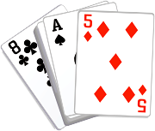
Maths at Home - KS2
A prominent clock- digital and analogue is even better. Place it somewhere where you can talk about the time each day.
A traditional wall calendar-Calendars help with counting days, spotting number patterns and
Board games that involve dice or spinners-helps with counting and the idea of chance
A pack of playing cards- Card games can be adapted in many ways to learn about number bonds, chance, adding and subtracting
A calculator- A basic calculator will help with maths homework when required, there are also many calculator games you can play, too.
Measuring Jug-Your child will use them in school, but seeing them used in real life is invaluable. Also useful for discussing converting from metric to imperial
Dried beans, Macaroni or Smarties- for counting and estimating
A tape measure and a ruler- Let your child help when measuring up for furniture, curtains etc
A large bar of chocolate (one divided into chunks)- a great motivator for fractions work
Fridge magnets with numbers on- can be used for a little practice of written methods
Indoor/outdoor Thermometer- especially useful in winter for teaching negative numbers when the temperature drops below freezing
Unusual dice- not all dice have faces 1-6, hexagonal dice, coloured dice, dice from board games all make talking about chance a little more interesting
A dartboard with velcro darts- Helps with doubling, trebling, adding and subtracting.
Ideas taken from Maths for Mums and Dads Eastaway, R. and Askew, M. (2010)

Slide 16
Thank you!
Please feel free to visit the classrooms where you will see lots of maths happening.
Look out for children using CPA – Concrete, Pictorial, Abstract.
Can you see any children ACEing it? Answer, Convince, Explain.

